Slide 1
GPIO Programming– ATMEGA 328
Dr.Sreejith Rajan

Slide 2
Introduction
What is AVR?
Architecture by Alf-Egil Bogen and Vegard Wollan.
Family of 8-bit RISC microcontrollers
Developed by Atmel (now Microchip)
Widely used in Arduino boards, embedded systems, and consumer electronics

Slide 3
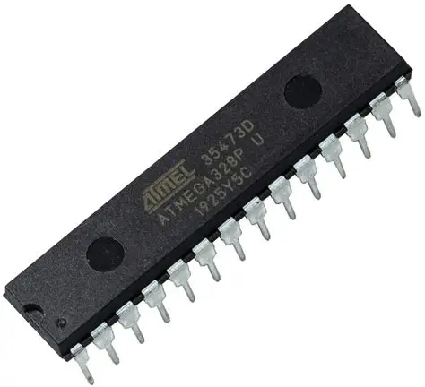
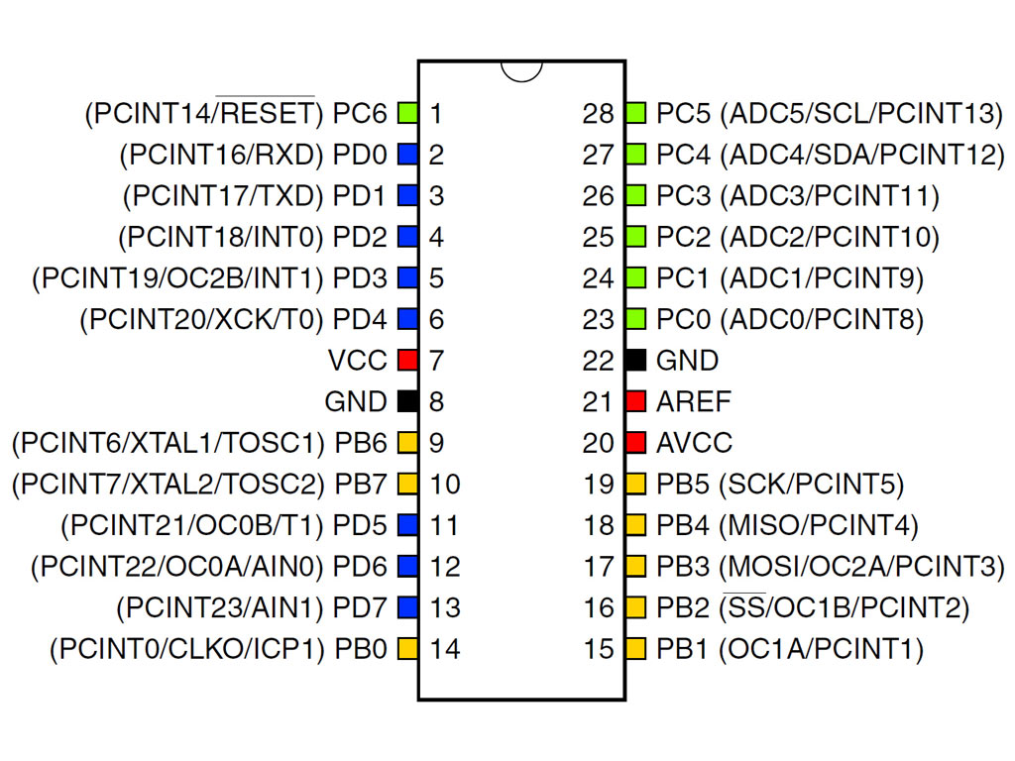
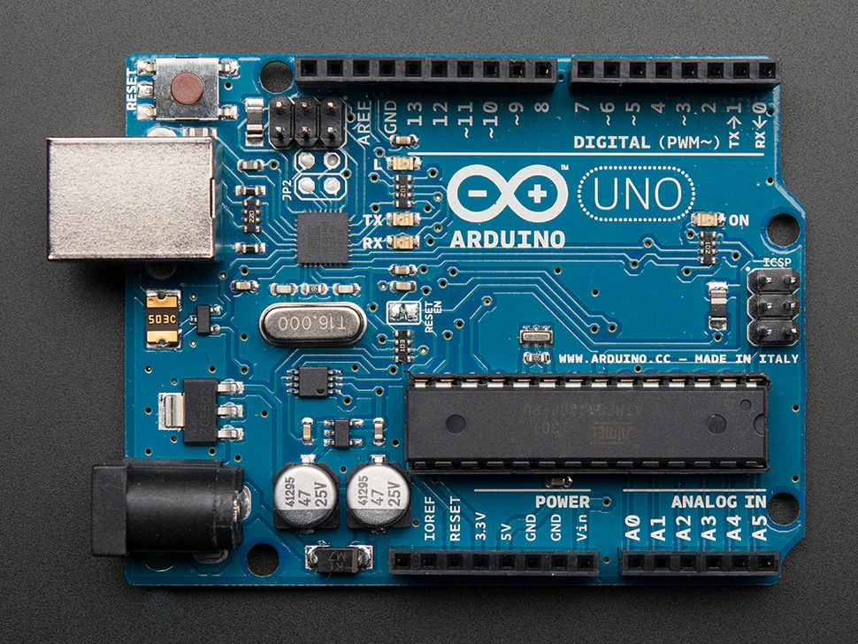
ATMEGA 328
0
1

Slide 4
ATMEGA 328
32K bytes of in-system programmable flash with read-while-write capabilities,
1K bytes EEPROM
2K bytes SRAM
23 general purpose I/O lines
32 general purpose working registers
Three flexible Timer/Counters with compare modes,
Internal and external interrupts
A serial programmable USART
An SPI serial port
A 6-channel 10-bit ADC
A programmable watchdog timer with internal oscillator,
And five software selectable power saving modes.
0
1

Slide 5
GPIO - General Purpose Input/Output
It refers to the digital pins on a microcontroller that can be programmed to either:
Input → to sense signals (e.g., button press, sensor output).
Output → to drive signals (e.g., turn an LED on/off, control a motor driver, send logic high/low to another circuit).
Total: 23 GPIO pins :
PORTB (8 pins, PB0–PB7)
PORTC (7 pins, PC0–PC6)
PORTD (8 pins, PD0–PD7)

Slide 6
ATMEGA 328 – GPIO Programming
4 Things to remember
Data Direction Register(DDRx) register
0 means that the pin is INPUT. 1means that the pin is OUTPUT
PORTx register (outputting value to a pin)
PINx Register (inputting value through a pin)
Bitwise operations
0

Slide 7
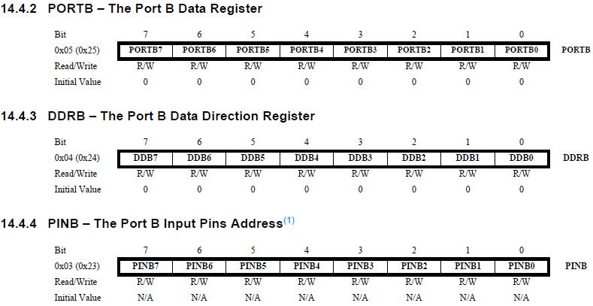
ATMEGA 328 – GPIO Programming
0

Slide 8
GPIO Programming – Pin as Output
Set the corresponding DDRB Bit to 1
DDRB|=(1<<DDB5) ; // Setting PORTB5 as output
Set the corresponding PORTx value to 1 to turn on (HIGH) OR 0 to turn off(LOW)
PORTB |= (1<<PORTB5); // turn on
PORTB &= ~(1<<PORT5);// turn off

Slide 9
GPIO Programming- Pin as Input
Active on Low input
Pull Up Resistor : A pull-up resistor is a resistor that connects an input pin to the positive supply voltage (Vcc).
Its job is to make sure the pin has a defined logic level (HIGH = 1) when the switch is open (not pressed).
0

Slide 10
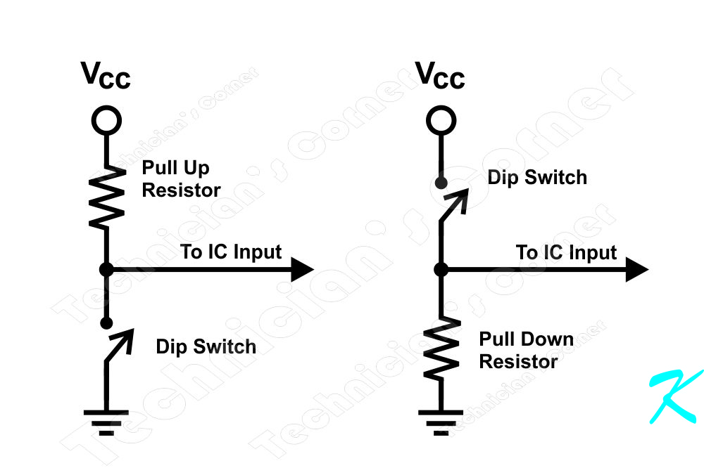
ATMEGA 328 – GPIO Programming
Active High Input
Pull-down resistor : is the opposite of a pull-up.It connects an input pin to ground (GND) through a resistor, ensuring the pin reads LOW (0) when the switch is open.
0

Slide 11
ATMEGA 328 – GPIO Programming
Let’s code
0

Slide 12
AVRDUDE
AVRDUDE = AVR Downloader/UploaDEr
It’s a command-line utility to program Atmel AVR microcontrollers (like ATmega328, ATmega16, ATtiny series).
It transfers your compiled program (.hex file) from your computer to the MCU’s flash memory using a programmer (USBasp, Arduino as ISP, AVRISP mkII, etc.).
0

Slide 13
AVRDUDE Installation
Search and fine AVRDUDE Page in Github.
Download the package suitable for your system
Add the path to system environment
Use it from Command line
0

Slide 14
Flash the code
We are using Arduino as a dev board
We can use it as a programmer
avrdude -v –p atmega328p -c arduino -P COMx -b115200 -U flash:w:“yourfile.hex”:i
0

Slide 15
Flash the code
1. avrdude : The tool that talks to your AVR microcontroller.
2. –v :Verbose mode → shows detailed messages (helpful for debugging).
3. -p atmega328p :Target part number.
4. -c Arduino :Programmer type. Here, arduino means Arduino bootloader protocol (STK500v1). Used when uploading via Arduino’s USB serial port.
5. -P COM3 :Port where the Arduino is connected.

Slide 16
Flash the code
6. -b 115200 :Baud rate.Tells AVRDUDE at what speed to talk over serial.
7. -U flash:w:yourfile.hex:i :Memory operation.
flash → target memory = flash program memory.
w → write.
yourfile.hex → the Intel HEX file you compiled
Basically this command says: “Use AVRDUDE, connect via COM3 at 115200 baud, talk to an ATmega328P using the Arduino bootloader protocol, and upload the file “yourfile.hex” into its flash memory. Print verbose logs while doing it.”

Slide 17
THANK YOU

